Slide 1
Installing
Data Science
in a business
Masterclass DISummit
Christophe Cop
Alexis Laks
Renaud Liber
Emidio Stani
Notes:
PArt 1: renaud

Slide 2
Some Context
1

Slide 3

“Data is the new Oil”
Clive Humby (2006)
Notes:
“Data is the new oil” Clive Humby said in 2006 but analogy used back by the economist in 2017 and became a general saying in our practice.
It says it all - Data is ressource and should be leveraged.
Not doing so in a business is a missed opportunity.

Slide 4





Data Amount
Data is growing exponentially
Thanks to continuous technology innovation
5G
But what to do with all that “oil”?
Blockchain
Genomics
AR
Computer Vision
Internet
Smartphone
Cheap storage
IOT
Time

Slide 5



Give it to a data scientist or a data person
and expect her/him to turn it into “GOLD”.
Notes:
Though this might work - and we can through Exploratory Data Analytics find some good leads it is key to work closely to the business.
Efforts and courage are not enough without purpose and direction (John F Kennedy)

Slide 6
The Analytics environment
01
Innovation
02
Infrastructure
Innovation
Infrastructure
Companies face complex & changing business environments.
Data analytics is often considered as the key enabler for innovation.
Cloud technology enable any business getting right IT infrastructure in time records to enable any Analytics
03
04
Business model
Regulation
Ensure that the data strategy benefits the overall business strategy.
Regulation should not be considered as a constraint, but as a new variable to be conscious about and integrate..
Business model
Regulation
Notes:
Innovation : Ubber, Aribnb, Stitch Fix, Khan Academy,
Infrastructure : no up front cost it brings all the right capacity to store the data, prep the data and even analyze it if desired.
Business Model : You want your data science initiative to impact the bottom line. It will give credibility to your data science team. To achieve this you need to ensure that both data strategy & business strategy are aligned
Regulation : GDPR announced 3 year ago and now live for 1 year - FEAR - Stock management, pricing - even anonymizing data as a whole quite many thing can be done - clustering customer to redifine you marketing strategy

Slide 7
A journey in analytics (light case scenario)
Explore Innovation & Opportunities
Congratulation, you are on the right track.
Define next problem you want to tackle.
Business Problem
Define what is the Business problem you would like to solve.
This helps ensure right direction.
Step 1
Mauris consectetuer ullamcorper quam.
Step 4
Mauris consectetuer ullamcorper quam.
Improve business performance
Translate your data science findings to the business and processes.
Measure the actual ROI once everything in place.
Build your data foundation
Do you have the data? What is the format?
80% of data scientist work is retrieving, cleaning the data.
Start to tinker and implement right process around data management (Governance, Quality…)
BUSINESS FOCUSED
Step 2
Mauris consectetuer ullamcorper quam.
Step 3
Mauris consectetuer ullamcorper quam.
Apply advanced analytics
Now it is fun time. EDA, Feature Engineering, More Data Cleaning, Machine learning, Model Explainability - but make sure it is linked to the original Business problem.
Tie back with your stakeholders to validate your findings.

Slide 8

Preliminary aspect of data science
Strategy
Development
Delivery
Operations
Data Access & Quality
Pilot
Operational change
Visualisation
Readiness Assessment
Business Case
POC’s
New insights to New questions
Stake holders
Algo
Notes:
Strategy
Often a very vague and general question
Identify business needs
Is there a need for data science?
Invite stakeholders for first conversations, acquiring business understanding
Towards concrete Proposals
Development
Dive in the Data - Availability, Quality, Format
Which stack do we want to use?
Will we implement a mid term project (POC)?
Keep the communication with all stakeholders open!
Delivery

Slide 9
Interlocking aspects for doing data science
Strategy
Development
Delivery
Operations
Business/ Innovation
Enablement
Target operating model
Data Access & Quality
Experience centre
Technical design
Pilot
Chief Data Officer
Operational change
Data vision
Roadmap
Ecosystem/ Technology Stack
Data lakes
Visualisation
Meta data management
Knowledge management
Model oversight
Readiness Assessment
Business Case
Sandbox
environment
POC’s
Data connectors
New insights to New questions
legal
Post implementation Maturity assessment
Principles for
Architecture Design
Migration Operation
Stake holders
Architecture governance
GDPR
API
Algo
Deployment
Optimisation validation
documentation
Data Maturity Assessment
Data science and AI vision
GIT
Security
Devops
Reporting tools
Automation
Model security testing
Notes:
Strategy :
Architecture : As you are getting more and more data - and data vairety in term of type you will want to think about Architecture - where are you going to store it - multi cloud solution?
Business innovation : We touch on that - but many companies are building there company on their data - do we have such opportunity - can your data be differentiator
Development :
Sandbox : As your product are use for operations, it will be important when a new software release happen that you test first. No impact to be usiness Does it break anything?
Git : As you are getting more people on board it will be valuable to all work on same code - as well to ensure continuity if your data scientist leave
Delivery
API : Either to futher utilize your model on the ground or to accelerate the product development of your data science team does AWS API, Azure or Google API (ie NLP)
Operations
Model oversight : through time your algorithm might decrease - it is important to look out for Algorithm decay and when it happens you might need to retrain it.
Knowledge management : You have all that insight how to make share it is shared with the right people in your company

Slide 10
Pratical examples
2

Slide 11
Digital
media
company
Example 1

Slide 12
What does the business want to achieve?
Kun
Business/ Innovation
Enablement
Business Case
Data science and AI vision
Can we implement a dynamic paywall system that adapts to the user/customer?
Kun
Can we predict the propensity to pay for a subscription, based on the online customer behavior and extra data like demographic information?

Slide 13
Prediction of propensity to pay for digital content
content provider
4
Optimisation validation
Roadmap
POC’s
Piloting
Test the model
documentation
3
Develop a machine learning model
Big data
New insights to New questions
2
Architecture and analysis of technical requirements
Target Architecture
Sandbox
environment
1
Gather data and business insights
Stake holders
Data connectors

Slide 14

Gather data and business insights
Targeting Team
Business/ Innovation
Enablement
Marketing
Content providers
Past research
Customer Research
Stake holders
Data Maturity Assessment
Data scientists
Sales Team
GDPR
Data connectors
Technical design
Big Data team
Google experts
Scientific literature research

Slide 15

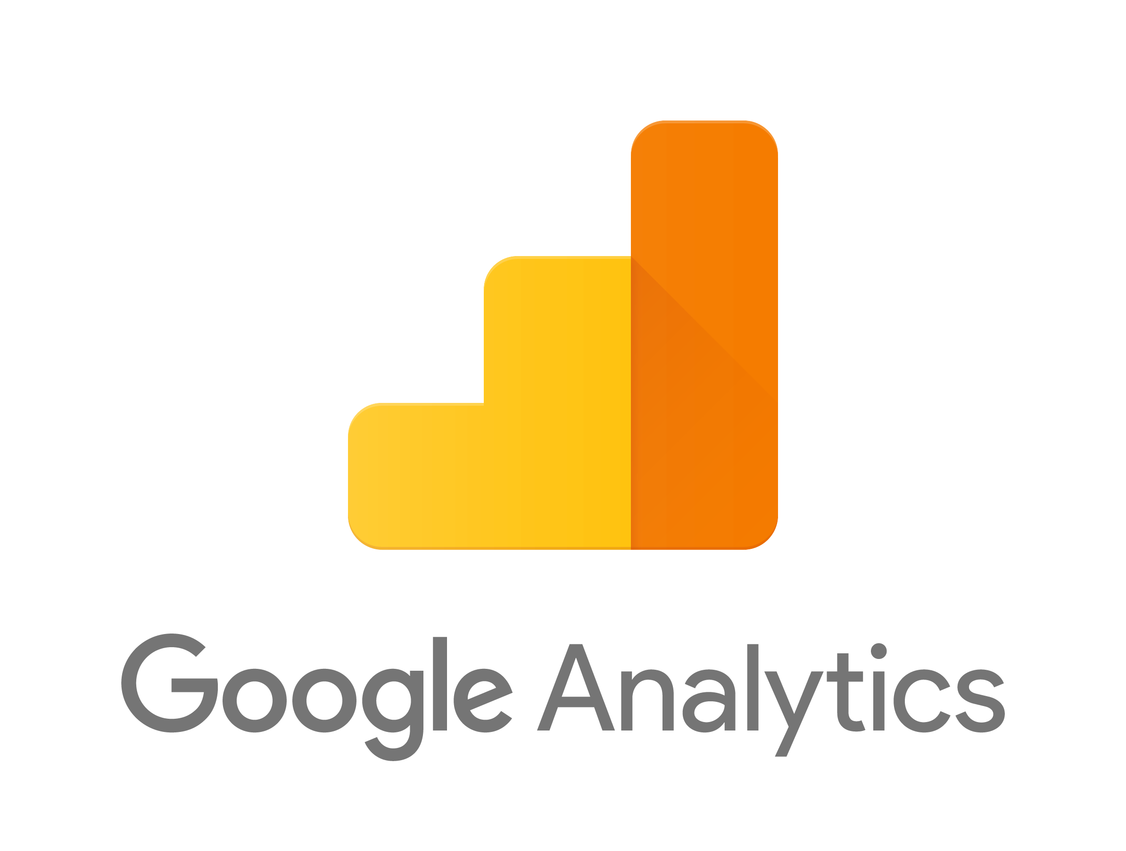





Architecture bases on Google Cloud Platform
Target Architecture
Ecosystem/ Technology Stack
Input
Output
User1 | P2P_1
User2 | P2P_2
User3 | P2P_3
Cloud Storage
BigQuery
Dataproc
Other data sources
Notes:
SQL & R (ML)

Slide 16
Develop a machine learning algorithm
POC’s
Data used:
Content
Demographics
Personal timeline actions
Average visits per day over last 30 days (Google clickstream)
Average views per day over last 30 days (Google clickstream)
Increase / decrease in views per days over last 30 days (Google clickstream)
Type of device being used at time of subscription (Google clickstream)
Other subscriptions & their type
Topics read about at day of subscription (Google clickstream)
Gender
Age category
Amount of information available (willingness to share)
Frequent location ZIP code, Province & population

Slide 17
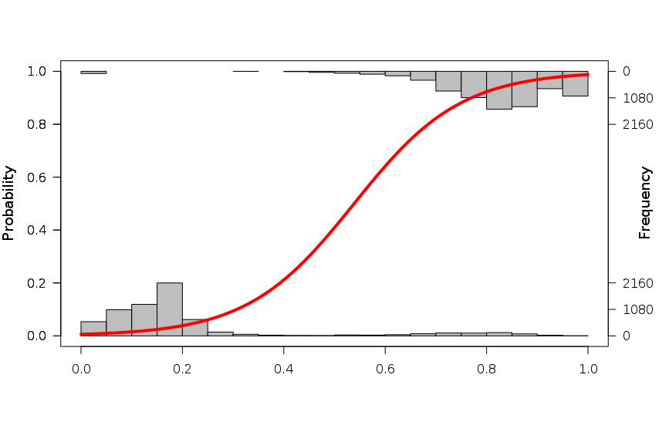
Develop a ML algorithm
POC’s
Visualisation
Een predictive model
Histogram of subscribed ppl
Fitted Curve
This group is the one that will get the manipulation
Histogram of unsubscribed ppl

Slide 18
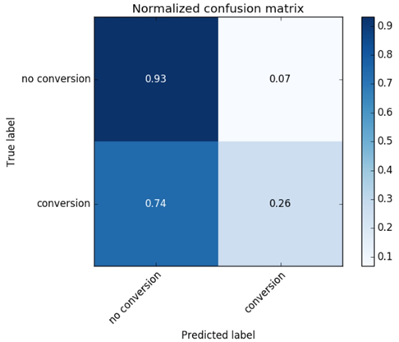
Model testing
Optimisation validation
Notes:
Very low number of subscriptions (1/1 000 000) => very hard to get high precision (many false positives)
=> prediction was factor 3 better, but needs much improvement.

Slide 19
What does the business want to achieve?
Kun
Business/ Innovation
Enablement
Business Case
Data science and AI vision
Can we implement a dynamic paywall system that adapts to the user/customer?
Kun
Can we predict the propensity to pay for a subscription, based on the online customer behavior and extra data like demographic information?

Slide 20
Prediction of propensity to pay for digital content
content provider
4
Optimisation validation
Roadmap
POC’s
Piloting
Test the model
documentation
3
Develop a machine learning model
Big data
New insights to New questions
2
Architecture and analysis of technical requirements
Target Architecture
Sandbox
environment
1
Gather data and business insights
Stake holders
Data connectors

Slide 21

Gather data and business insights
Targeting Team
Content providers
Customer Research
Business/ Innovation
Enablement
Marketing
Past research
Data Maturity Assessment
Stake holders
Data scientists
Sales Team
GDPR
Data connectors
Big Data team
Technical design
Scientific literature research
Google experts

Slide 22
Architecture bases on Google Cloud Platform
Target Architecture
Ecosystem/ Technology Stack
Input
Output
User1 | P2P_1
User2 | P2P_2
User3 | P2P_3
Cloud Storage
BigQuery
Dataproc
Other data sources
Notes:
SQL & R (ML)

Slide 23
Develop a machine learning algorithm
POC’s
Data used:
Content
Demographics
Personal timeline actions
Average visits per day over last 30 days (Google clickstream)
Average views per day over last 30 days (Google clickstream)
Increase / decrease in views per days over last 30 days (Google clickstream)
Type of device being used at time of subscription (Google clickstream)
Other subscriptions & their type
Topics read about at day of subscription (Google clickstream)
Gender
Age category
Amount of information available (willingness to share)
Frequent location ZIP code, Province & population

Slide 24
Develop a ML algorithm
POC’s
Visualisation
Een predictive model
Histogram of subscribed ppl
Fitted Curve
This group is the one that will get the manipulation
Histogram of unsubscribed ppl

Slide 25
Model testing
Optimisation validation
Notes:
Very low number of subscriptions (1/1 000 000) => very hard to get high precision (many false positives)
=> prediction was factor 3 better, but needs much improvement.

Slide 26
Informatie Vlaanderen
Example 2
Notes:
R & SAS (Sas eguide)

Slide 27
Meeting citizens and business needs
Kun
As a citizen what how I get facilitated in my day to day life when interacting with my public administration ?
Kun
As public administration how can I provide public services efficiently ?

Slide 28
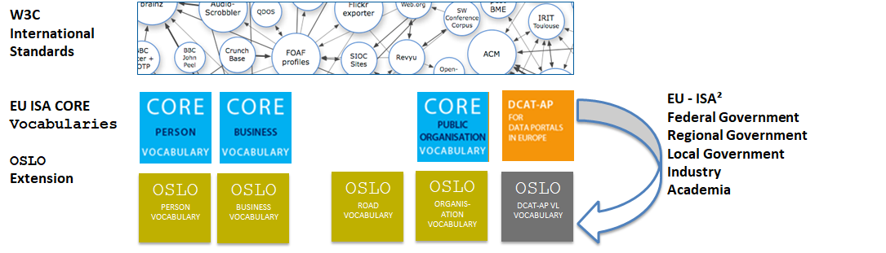
Interoperability as key to improve efficiency of public services
OSLO2 (Open Standards for Linked Organisations) is a standard managed by the Flemish Government with the objective to deliver services to citizens and businesses so that they only have to Ask Just Once.
Triple Helix approach: Government, Private Sector, Academia

Slide 29
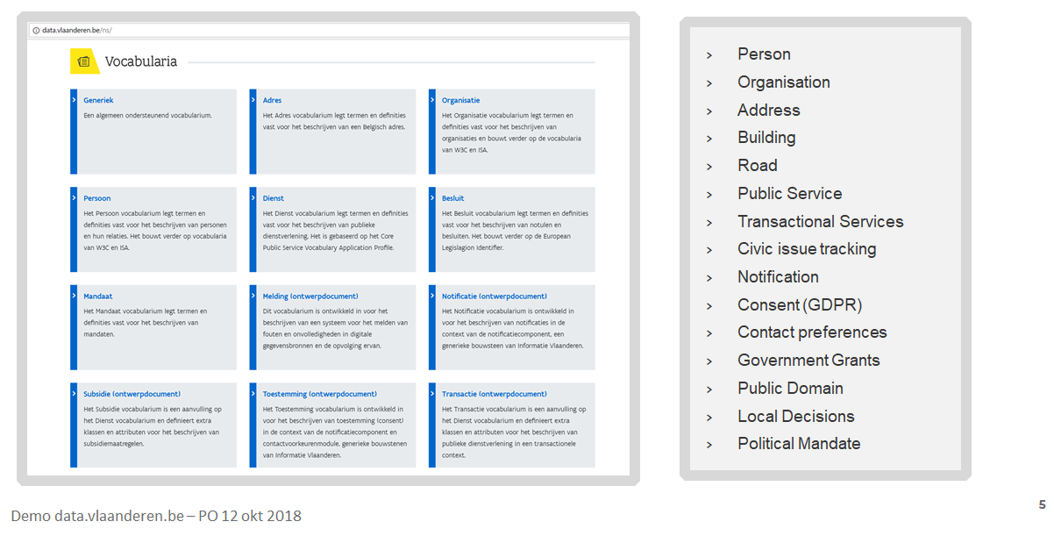
Vocabularies developed on different topics
https://data.vlaanderen.be/ns

Slide 30
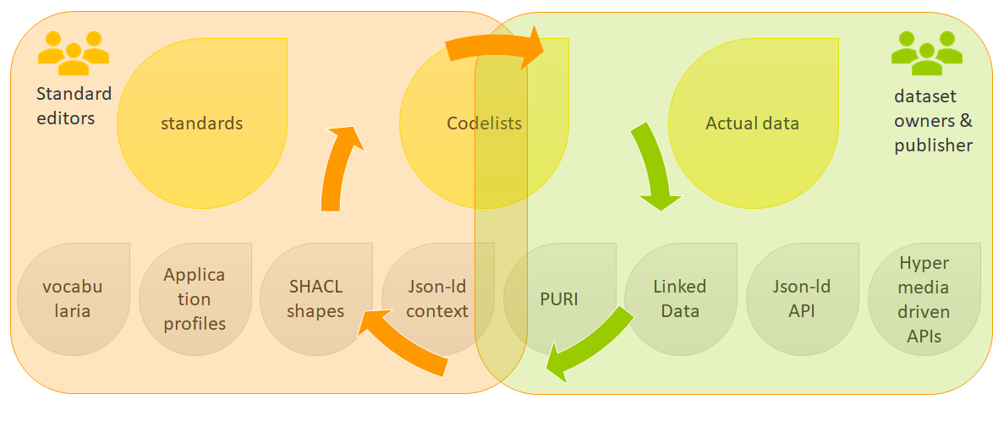
Ecosystem of artifacts
https://github.com/Informatievlaanderen

Slide 31
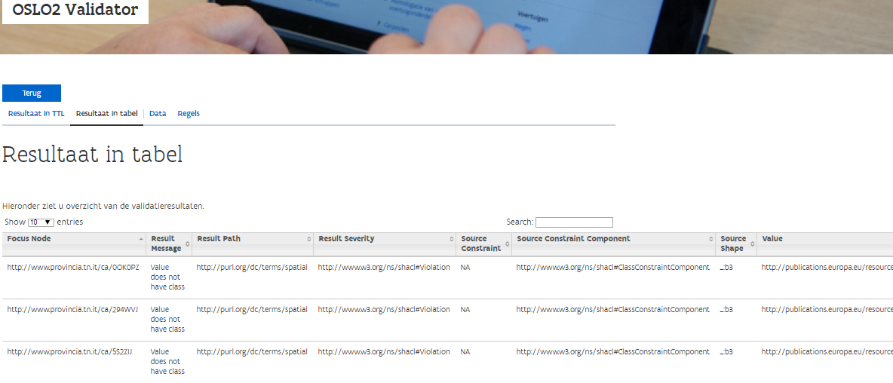
SHACL validator - objectives
Support analysts and developers with the adoption and implementation of OSLO data standards.

Slide 32
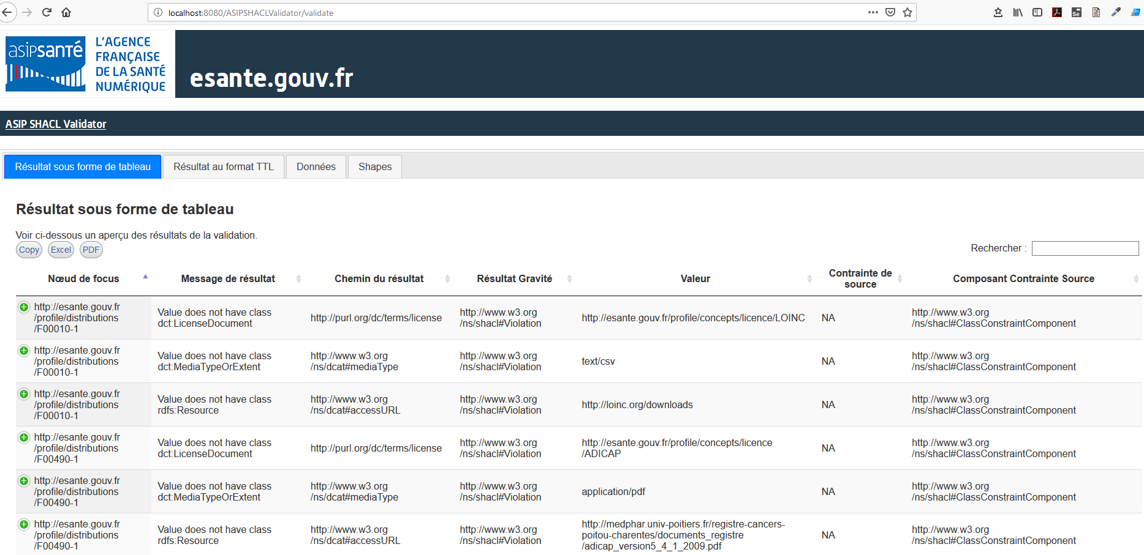
SHACL validator - reusers

Slide 33

Thank you and see you on GitHub

Slide 34
Digital Education Action Plan
Example 3
Notes:
R & SAS (Sas eguide)

Slide 35
What does the stakeholder want to achieve?
Kun
How can we identify skill trends/gaps in education programs in Europe?
Kun
How could data and Machine learning help us in defining up-to-date policies?

Slide 36
Map of linked skills
Programs
Skills
Jobs
Missing skills!

Slide 37

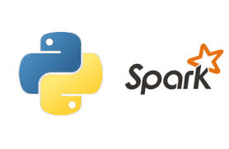
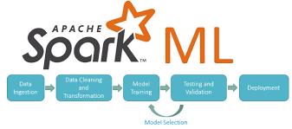

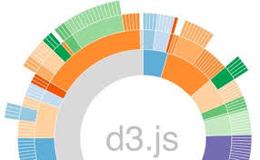

Matching education programs to jobs
NLP
2. Visualization
3. Output
http://34.245.7.232:3838/myapp/poc1/prototype1/
http://34.245.7.232:3838/myapp/poc2/prototype2/

Slide 38
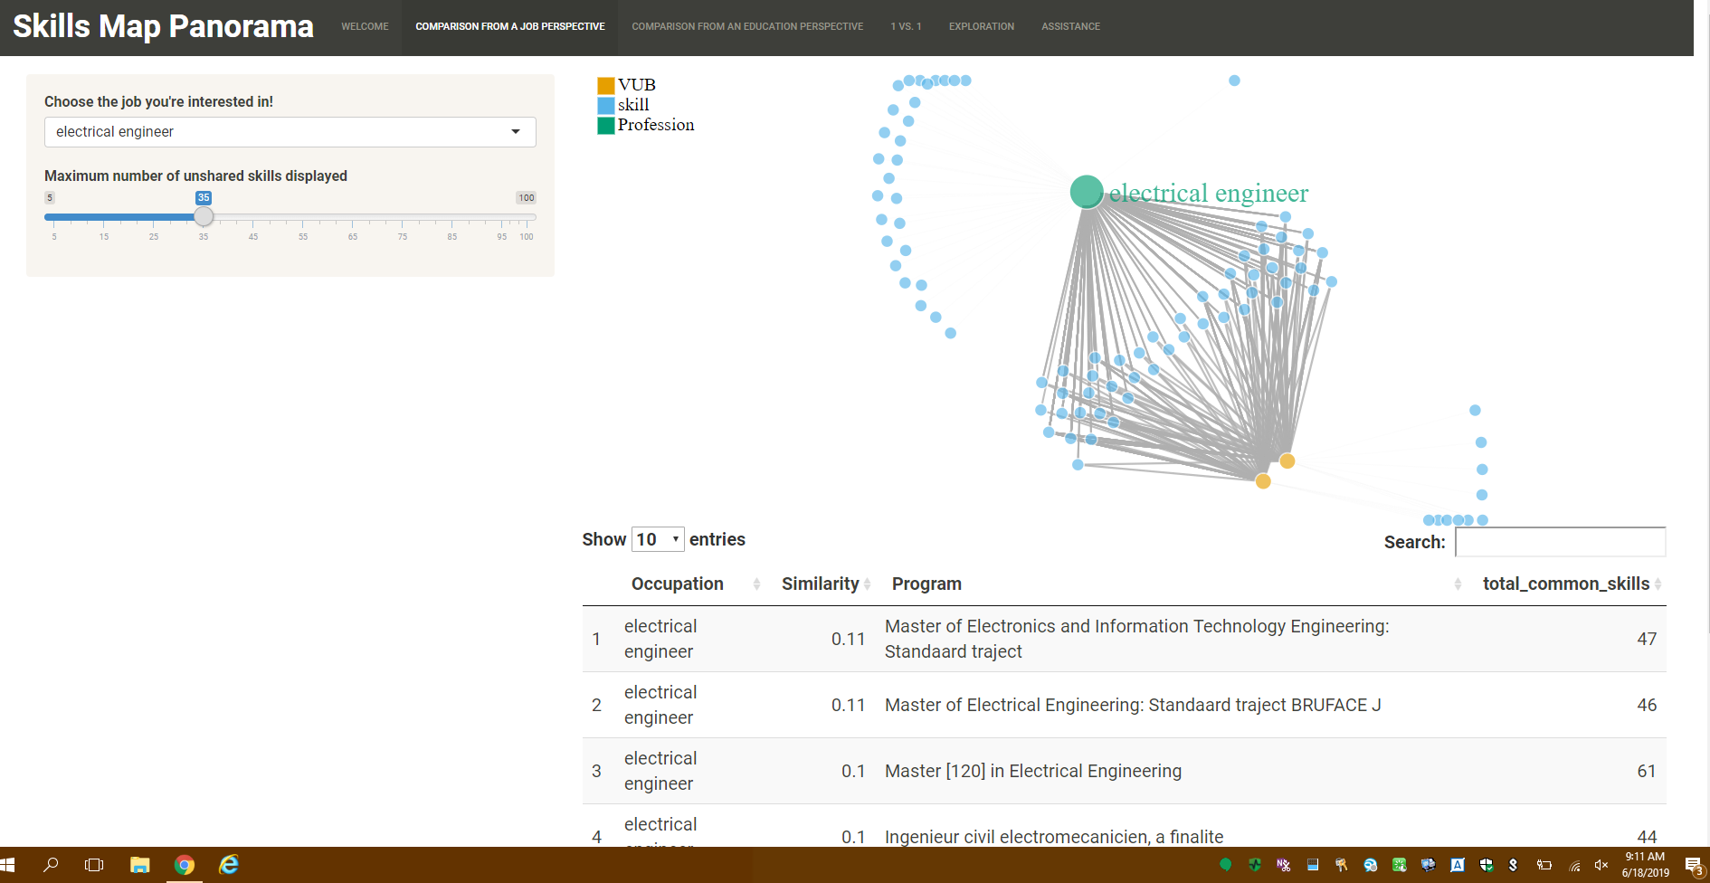

Slide 39
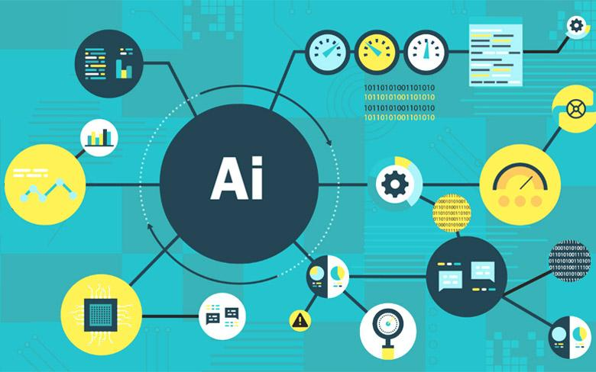
Data science for Business
Honeycomb LoS
Data scientist manager
Concern for scalability

Slide 40
Thank you
© 2019 PwC. All rights reserved. PwC refers to the PwC network and/or one or more of its member firms, each of which is a separate legal entity. Please see www.pwc.com/structure for further details.

Slide 41
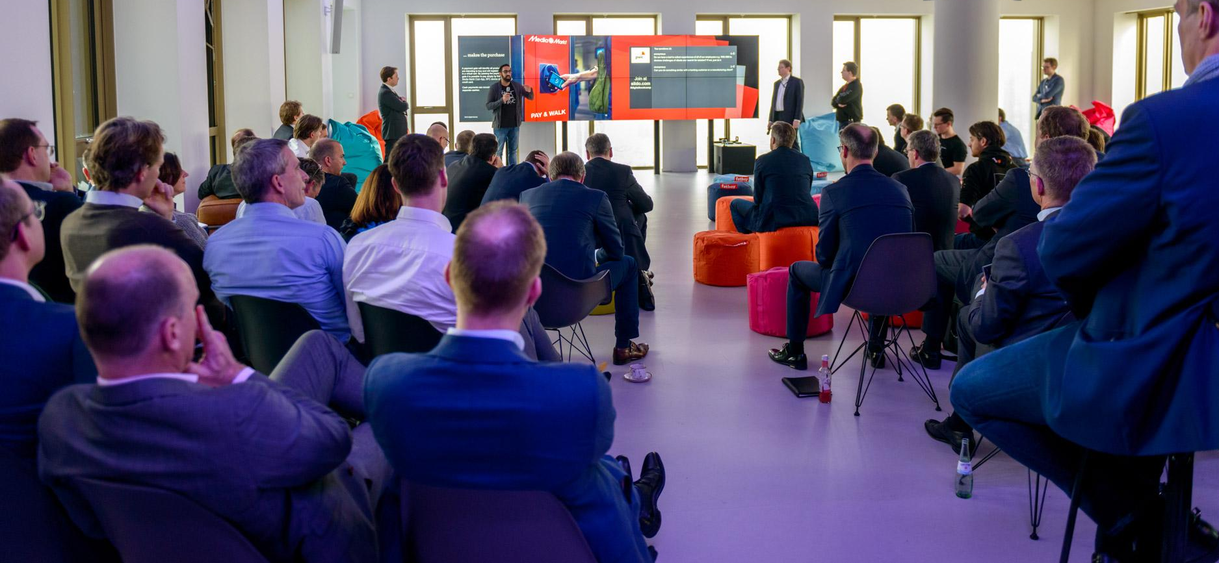
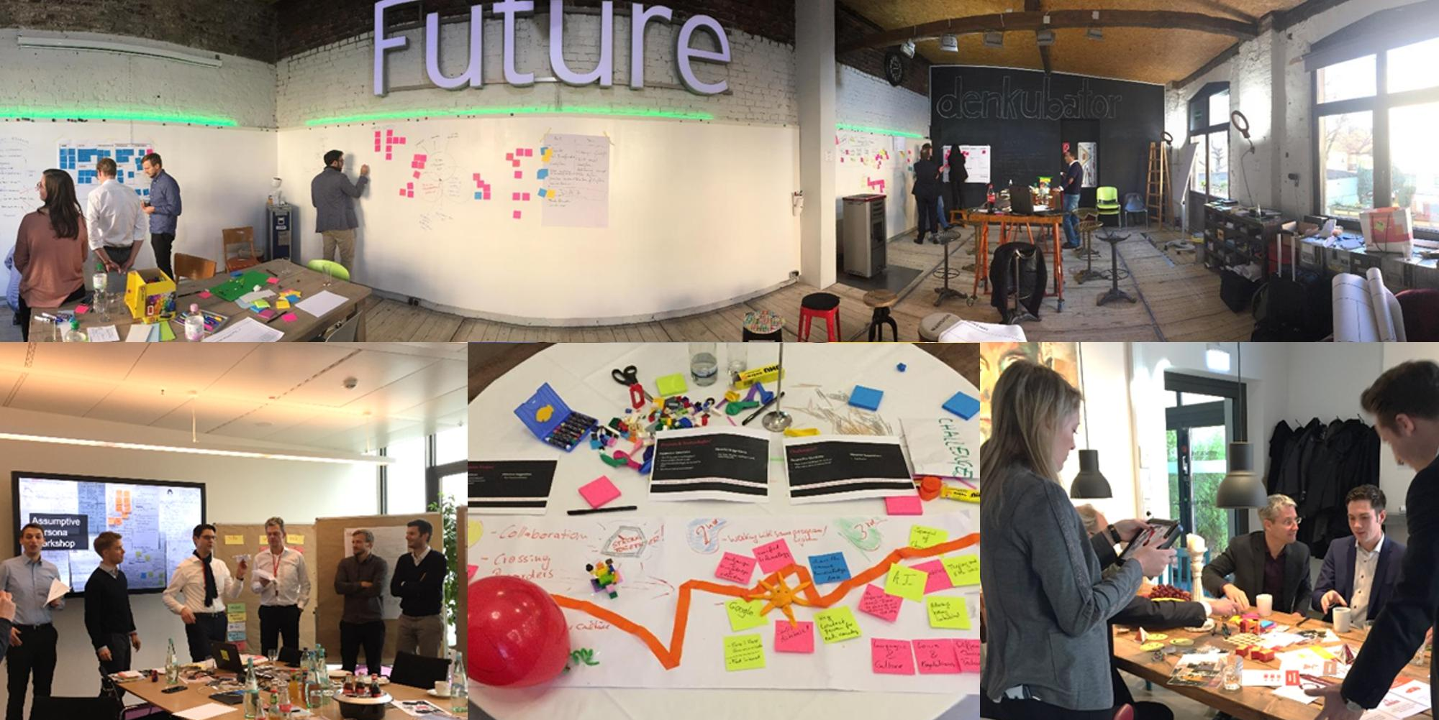
Impressions Experience Center Sandbox - The Difference
1
Data and insights
PwC Europe Experience Center
Confidential information for the sole benefit and use of PwC’s client.

Slide 42
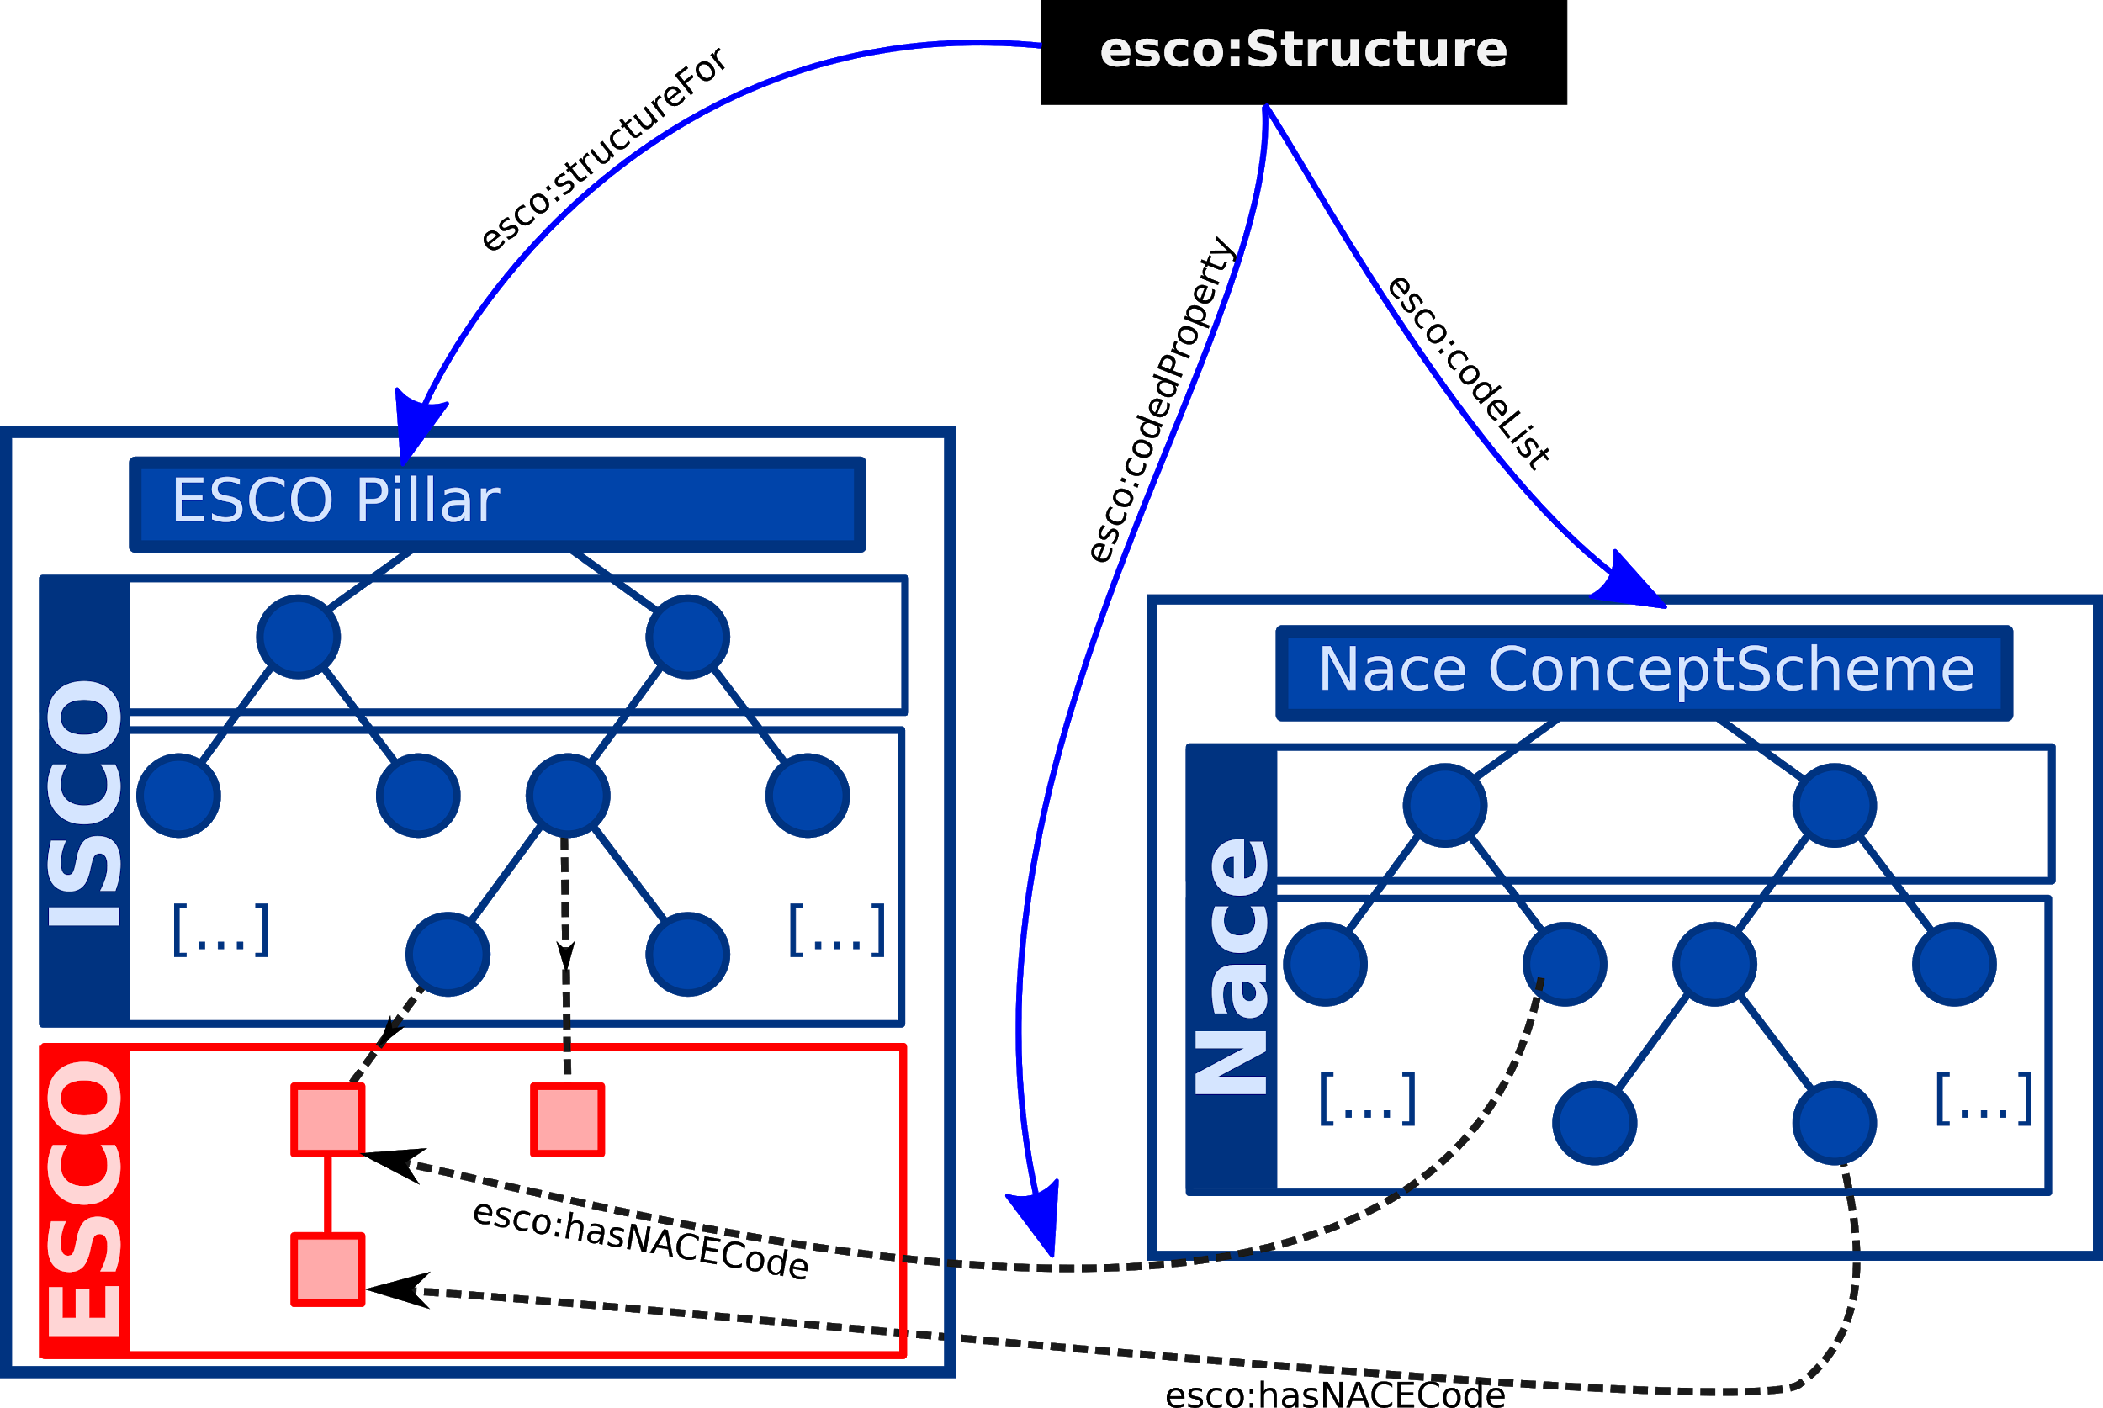
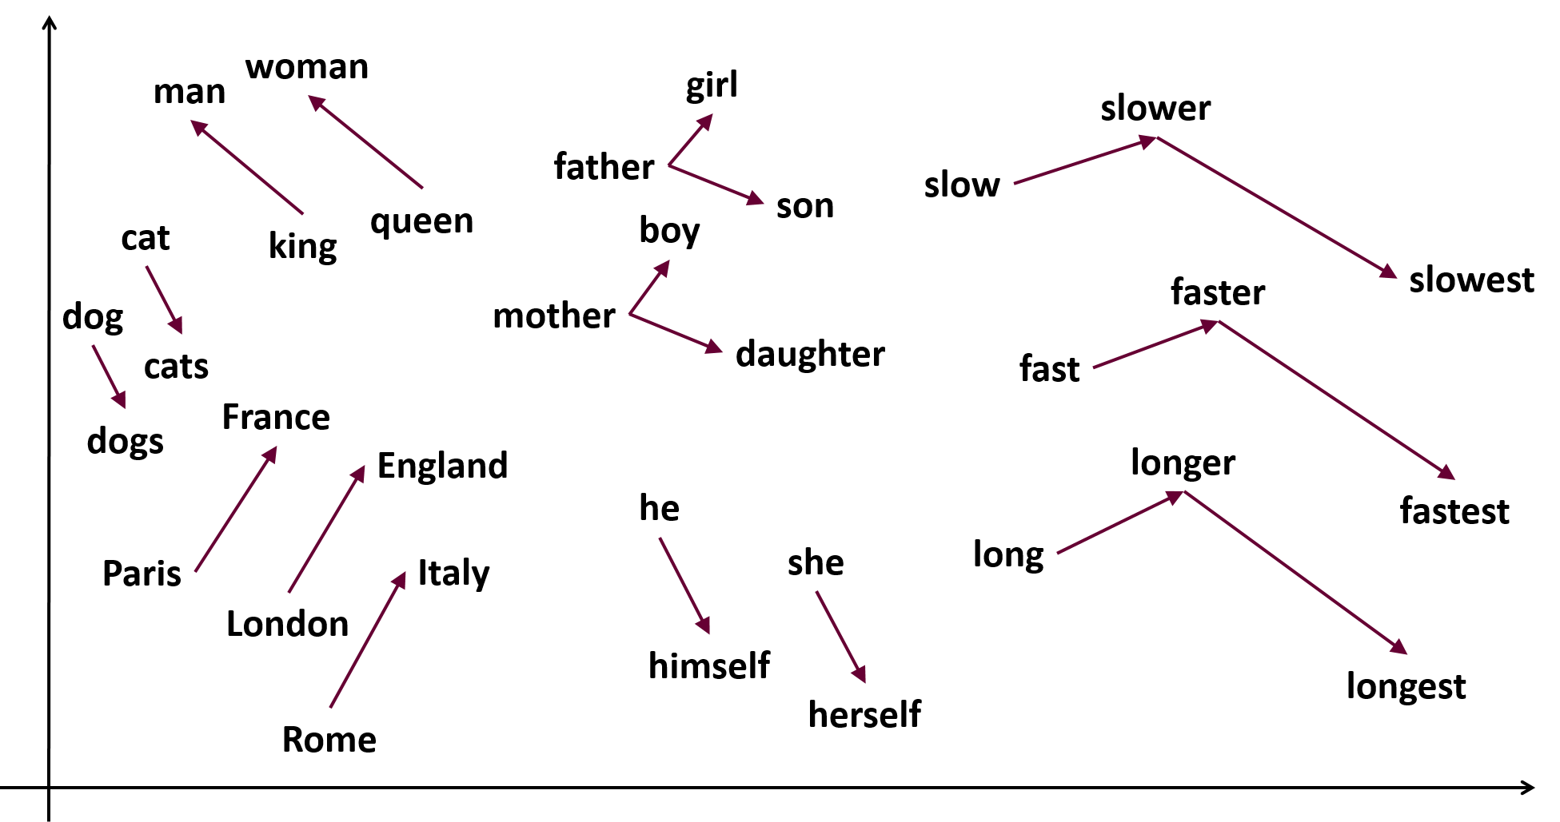
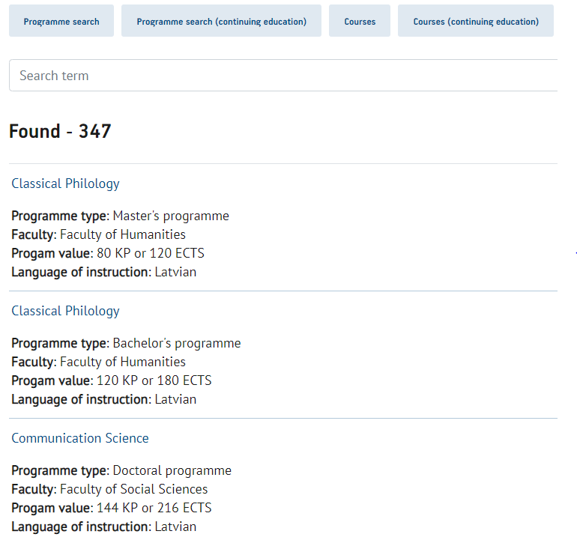
Google Word2VEC
ESCO + UNIV + NLP

Slide 43
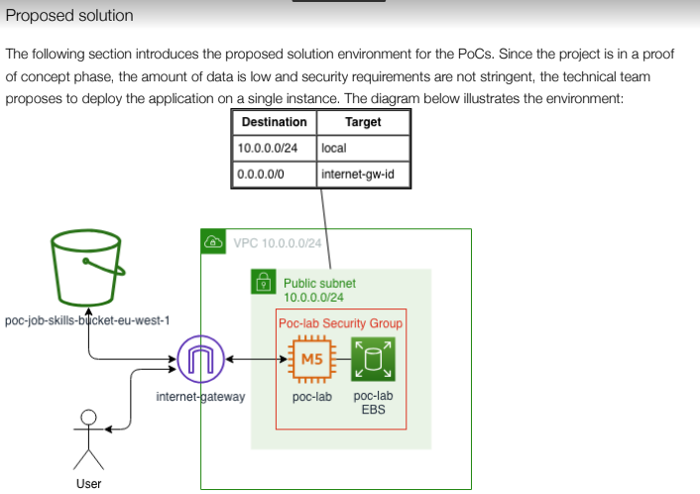
Set up of a cloud environment
2
Architecture and analysis of technical specs
Cloud environment to host user friendly platform (Shinyapp)
Make data insights and their business value directly actionnable
Avoid the “technical” barrier (public IPv4) easy access!

Slide 44



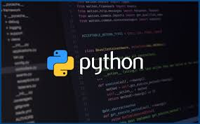
ML/NLP Strategy
3
Development of a machine learning model
Many algorithms are available out there for string matching. Where to start?
Parallelize your code! Faster computations and bigger capacity, prove that your idea is scalable

Slide 45
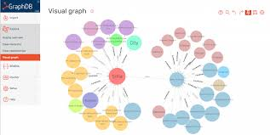

4
Test the model
Accuracy of the model goes without say - but how do you assess accuracy here?
Importance of visualization & scalability
More traffic will lead to validity - Qualitative view and long term testing

Slide 46
(other projects
Example maxim
Legal & highly confidential data
=> Impact of entire company =
WHy this data? Which data
Don’t be afraid of the legal.

Slide 47
Back Up

Slide 48
First engagement with Stakeholders
Strategy
Business/ Innovation
Enablement
Target operating model
Often a very vague and general question
Identify business needs
Is there a need for data science?
Assessment of the current modus operandi
Invite stakeholders for first conversations, acquiring business understanding
Towards concrete Proposals
Data vision
Roadmap
Readiness Assessment
Business Case
Principles for
Architecture Design
Migration Operation
Stake holders
Data Maturity Assessment
Data science and AI vision

Slide 49
A Project is chosen / agreed
Development
Dive in the Data - Availability, Quality, Format
Which stack do we want to use
Will we implement a mid term project (POC)
Keep the communication with all stakeholders open!
Data Access & Quality
Experience centre
Ecosystem/ Technology Stack
Data lakes
Sandbox
environment
POC’s
Architecture governance
GDPR
GITHUB
Security

Slide 50
Present
Delivery
Technical design
Piloting
Visualisation
Meta data management
Data connectors
New insights to New questions
API
Algo
Deployment
Devops
Reporting tools

Slide 51
Operations
Chief Data Officer
Type II thinking
Knowledge management
Model Decay
Legal
Post implementation Maturity assessment
Measure ROI
documentation
Automation
Model security testing
‹#›

